Slide 1
Lesson 5: Pandas

Slide 2
Getting and Knowing your Data

Slide 3

Getting and Knowing your Data
Step 1: Import necessary libraries
Step 2: Import the dataset from here
Step 3: Assign it to a variable called df.

Slide 4
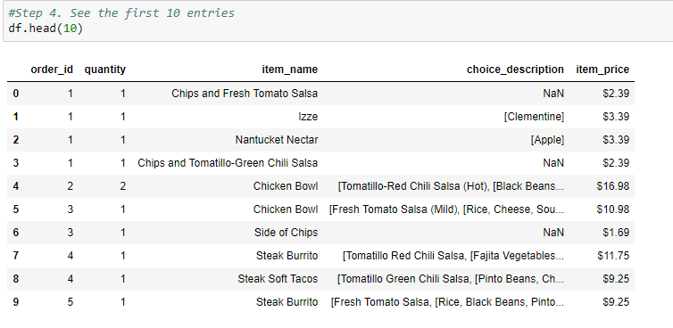
Getting and Knowing your Data

Slide 5
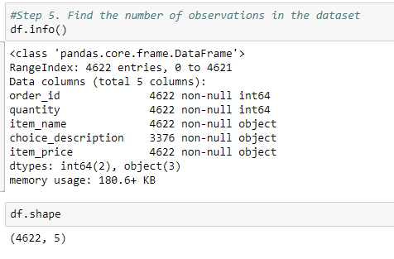
Getting and Knowing your Data

Slide 6
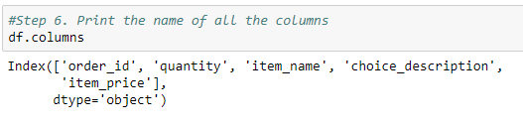

Getting and Knowing your Data

Slide 7
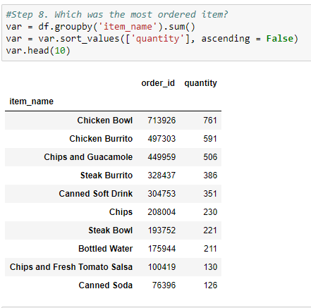
Getting and Knowing your Data

Slide 8
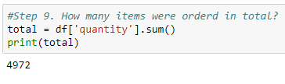
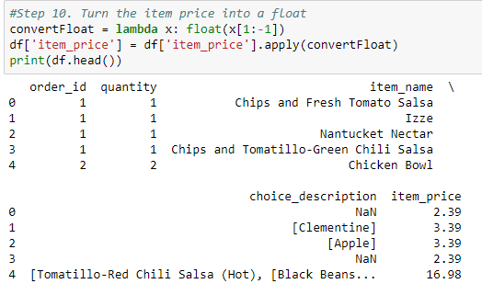
Getting and Knowing your Data

Slide 9
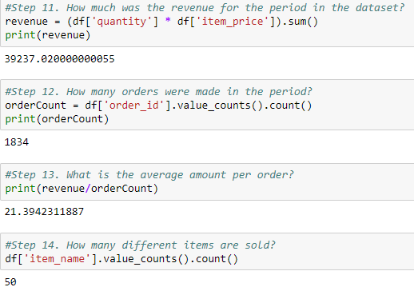
Getting and Knowing your Data

Slide 10
Filtering and Sorting Data

Slide 11
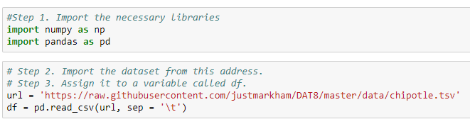
Filtering and Sorting Data

Slide 12
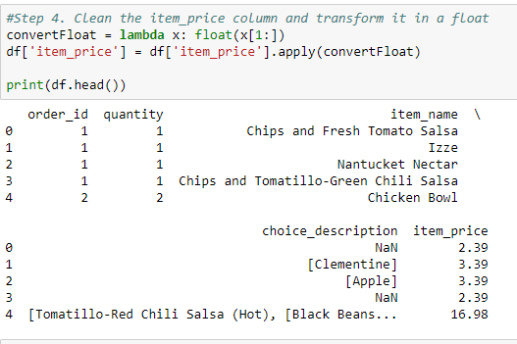
Filtering and Sorting Data

Slide 13
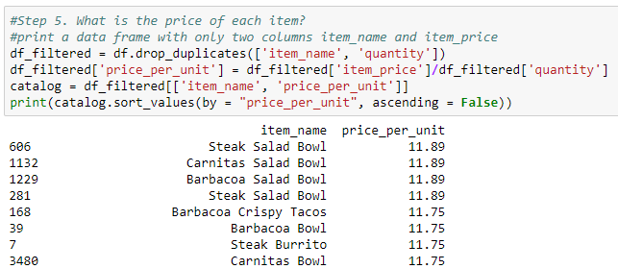
Filtering and Sorting Data

Slide 14
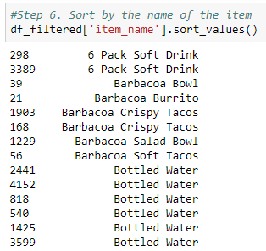
Filtering and Sorting Data

Slide 15
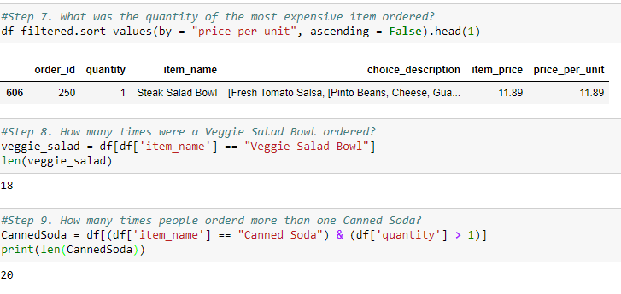
Filtering and Sorting Data

Slide 16
Visualization

Slide 17
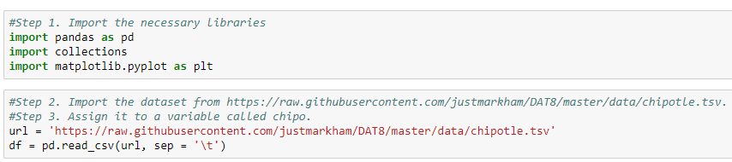
Visualization

Slide 18
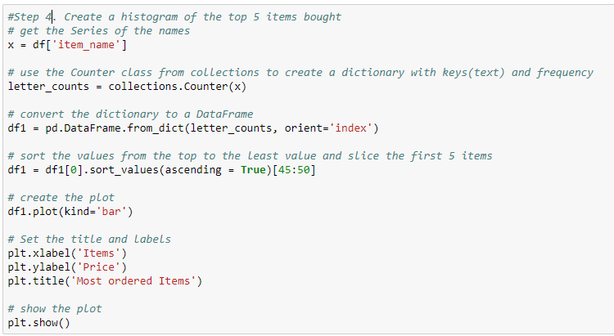
Visualization

Slide 19
Visualization

Slide 20
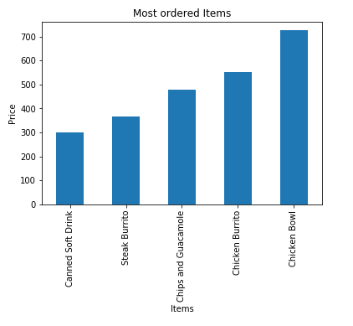
Visualization

Slide 21
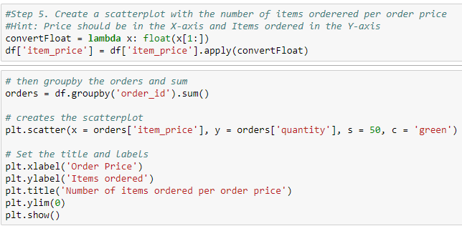
Visualization

Slide 22
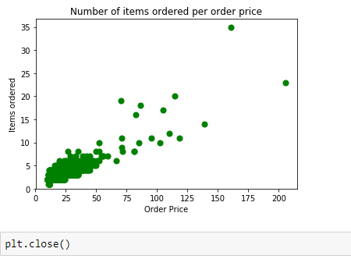
Visualization

Slide 23
Missing Values

Slide 24
Missing Values
Missing data is always a problem in real life scenarios.
Areas like machine learning and data mining face severe issues in the accuracy of their model predictions because of poor quality of data caused by missing values.
In these areas, missing value treatment is a major point of focus to make their models more accurate and valid.
When and Why Is Data Missed?
Let us consider an online survey for a product. Many a times, people do not share all the information related to them. Few people share their experience, but not how long they are using the product; few people share how long they are using the product, their experience but not their contact information. Thus, in some or the other way a part of data is always missing, and this is very common in real time.

Slide 25
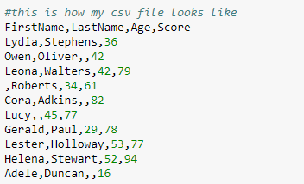
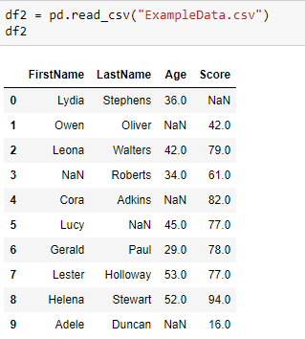
Missing Values
Let us now see how we can handle missing values (say NA or NaN) using Pandas.
Let us now see how we can handle missing values (say NA or NaN) using Pandas.

Slide 26
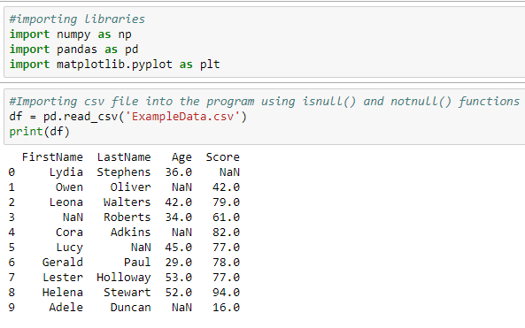
Missing Values

Slide 27
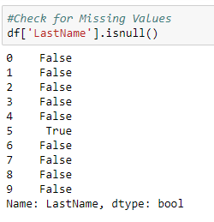
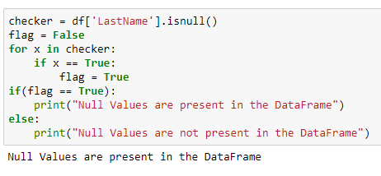
Missing Values

Slide 28
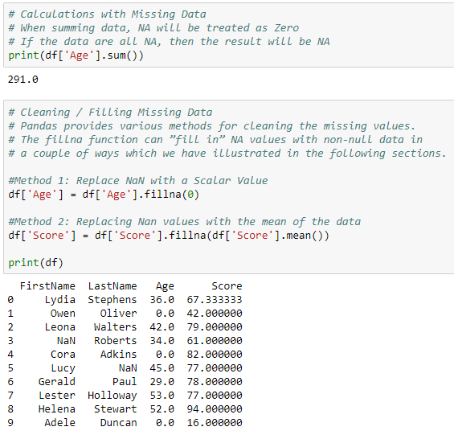
Missing Values

Slide 29
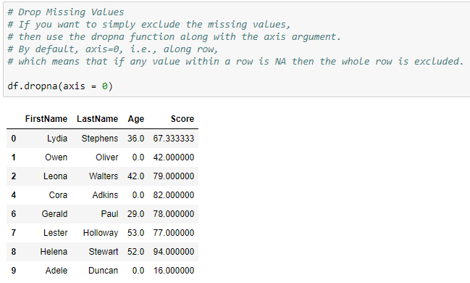
Missing Values

Slide 30
We’ll continue in next class..
Any questions?

